Slide 1
Software Engineering I
Dr. Elham Mahmoudzadeh
Isfahan University of Technology
mahmoudzadeh@iut.ac.ir
2024

Slide 2
Chapter 4 Functional Modeling(I)

Slide 3
Steps(I)
Preparing proposal
Requirements determination
User story
Abstract Business Process Modelling
Analysis
Functional Modelling
Structural Modelling
Behavioral Modelling

Slide 4
Steps(II)
Design
Optimization
Database Management
User Interface
Physical Architecture

Slide 5
Introduction
All object-oriented systems development approaches are use-case driven, architecture-centric, and iterative and incremental.
Use case is a formal way of representing the way a business system interacts with its environment.
Use case is a high-level overview of the business processes in a business information system.
Use cases represent the entire basis for an object-oriented system.
Use cases can document the current system (i.e., as-is system) or the new system being developed (i.e., to-be system).
Use cases also form the foundation for testing and user-interface design .

Slide 6
System modeling
System modeling is the process of developing abstract models of a system, with each model presenting a different view or perspective of that system.
System modeling has now come to mean representing a system using some kind of graphical notation, which is now almost always based on notations in the Unified Modeling Language (UML).
System modelling helps the analyst to understand the functionality of the system and models are used to communicate with customers.

Slide 7
System perspectives
An external perspective, where you model the context or environment of the system.
A structural perspective, where you model the organization of a system or the structure of the data that is processed by the system.
A behavioral perspective, where you model the dynamic behavior of the system and how it responds to events.

Slide 8
UML diagram types
Use case diagrams, which show the interactions between a system and its environment.
Activity diagrams, which show the activities involved in a process or in data processing .
Class diagrams, which show the object classes in the system and the associations between these classes.
Sequence diagrams, which show interactions between actors and the system and between system components.
State diagrams, which show how the system reacts to internal and external events.

Slide 9
Introduction(Cnt’d)
From an architecture-centric perspective, use-case modeling supports the creation of an external or functional view of a business process in that it shows how the users view the process rather than the internal mechanisms by which the process and supporting systems operate.

Slide 10
Introduction(Cnt’d)
Activity diagrams are typically used to augment our understanding of the business processes and our use-case model.
Technically, an activity diagram can be used for any type of process-modeling activity.

Slide 11
Introduction(Cnt’d)
Activity diagrams and use cases are logical models—models that describe the business domain’s activities without suggesting how they are conducted.
Logical models are sometimes referred to as problem domain models. Reading a use-case or activity diagram, in principle, should not indicate if an activity is computerized or manual.
These physical details are defined during design when the logical models are refined into physical models. These models provide information that is needed to ultimately build the system.
By focusing on logical activities first, analysts can focus on how the business should run without being distracted with implementation details.

Slide 12
Use-case Diagram
Employ the use-case diagram to better understand the functionality of the system at a very high level.
Because a use-case diagram provides a simple, straightforward way of communicating to the users exactly what the system will do, a use-case diagram is drawn when gathering and defining requirements for the system.
Use-case diagram can encourage the users to provide additional high-level requirements.
A use-case diagram illustrates in a very simple way the main functions of the system and the different kinds of users that will interact with it.

Slide 13
Let’s start
For identifying use cases, Jacobson et al. (1992) recommend that you ask the following questions: • What are the main tasks performed by each actor? • Will the actor read or update any information in the system? • Will the actor have to inform the system about changes outside the system? • Does the actor have to be informed of unexpected changes?

Slide 14
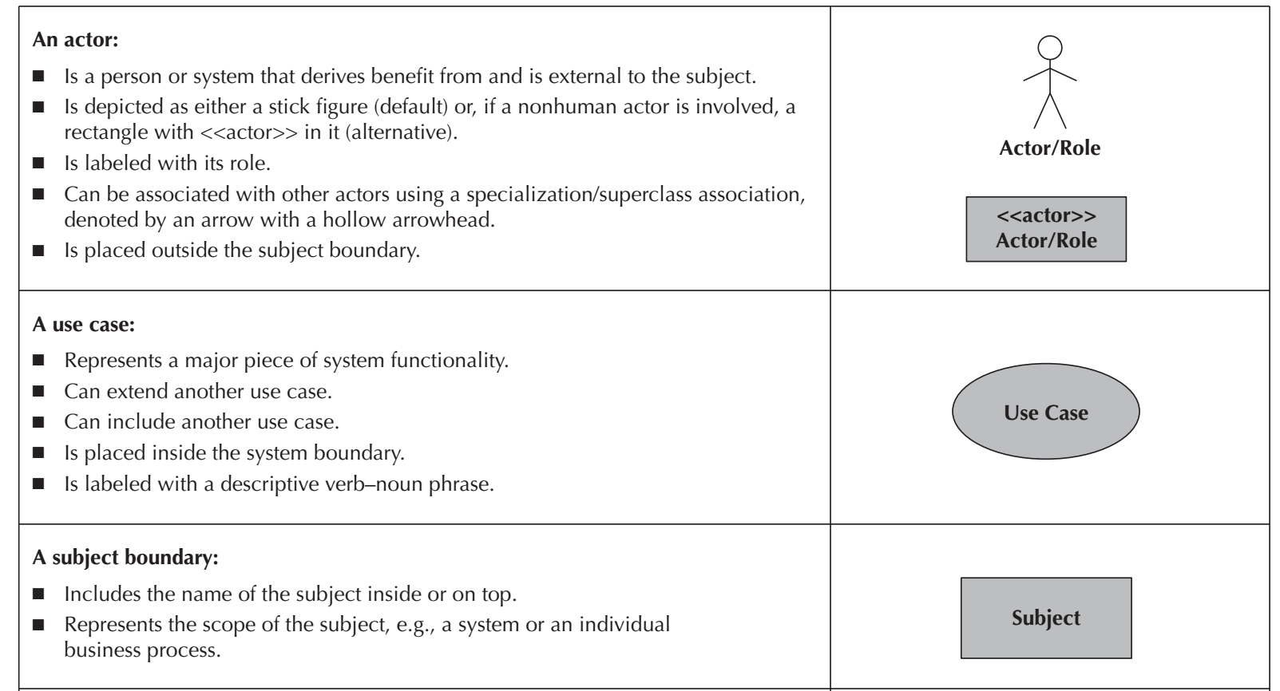
Elements of Use-Case Diagrams(I)

Slide 15
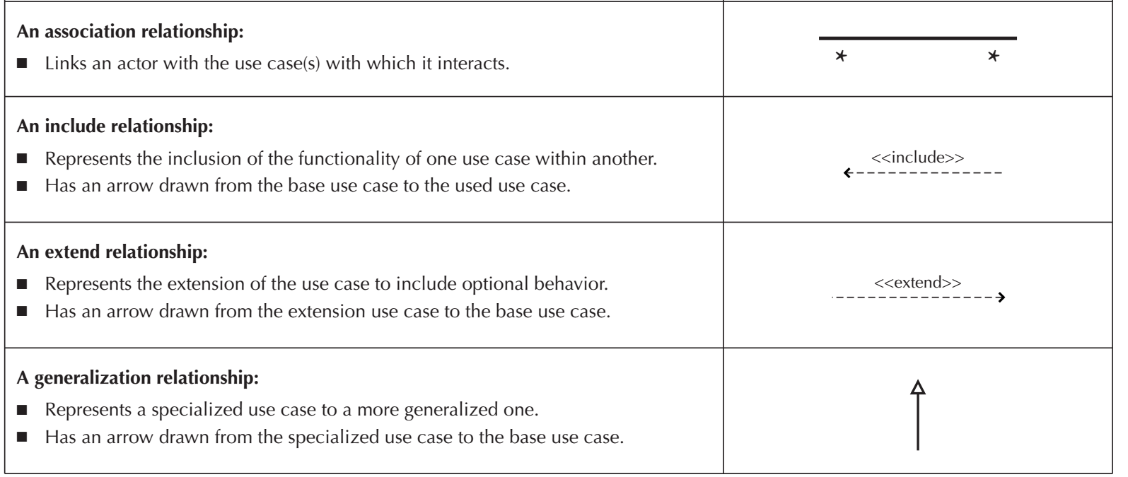
Elements of Use-Case Diagrams(II)

Slide 16
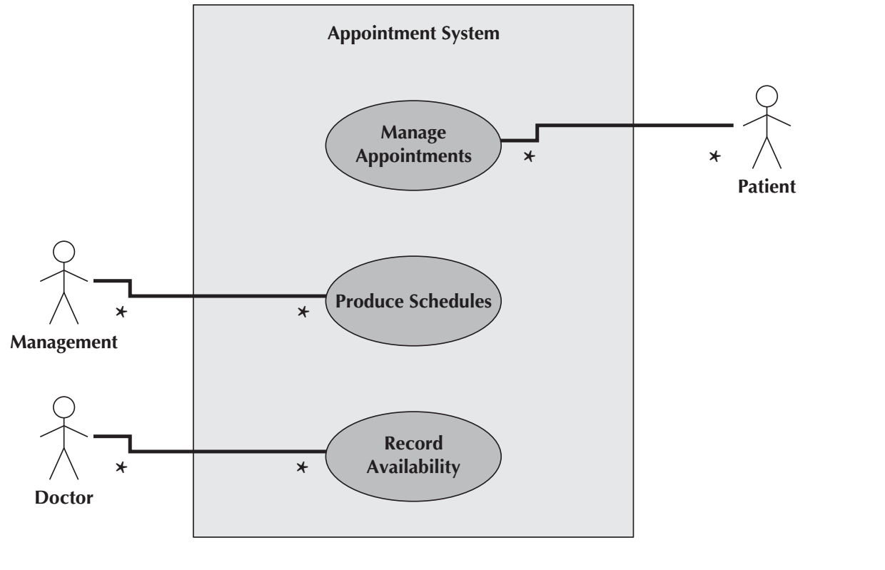
First Example

Slide 17
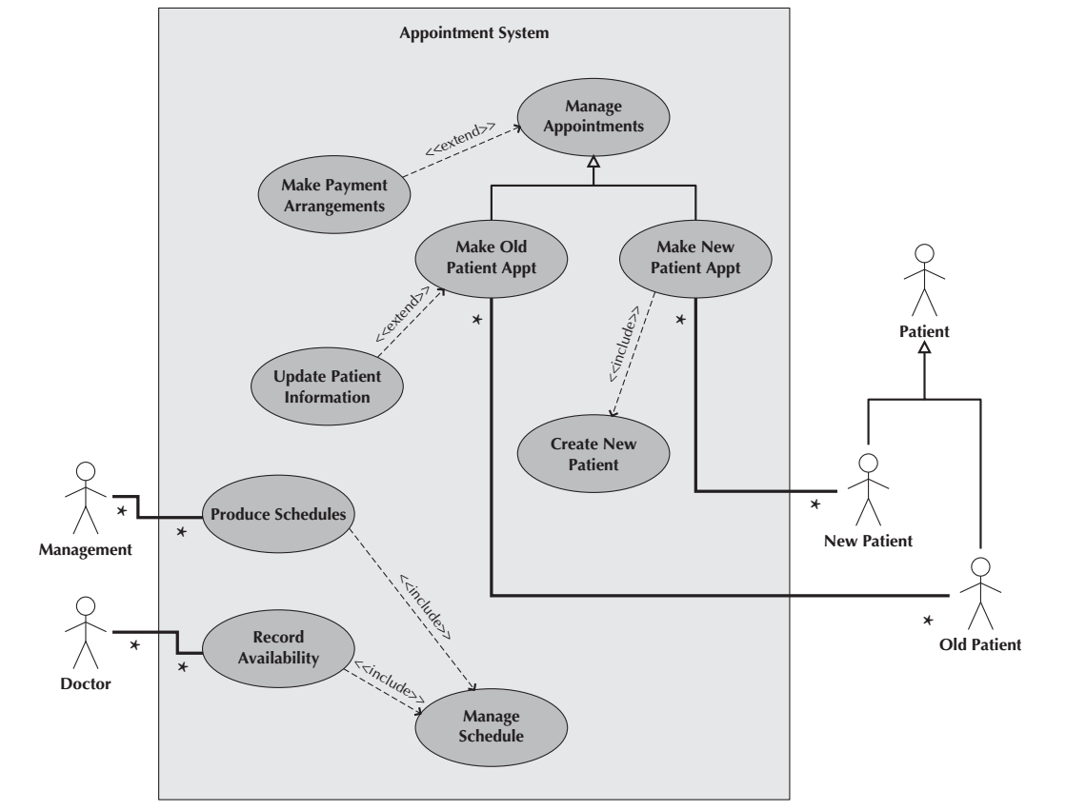

Slide 18
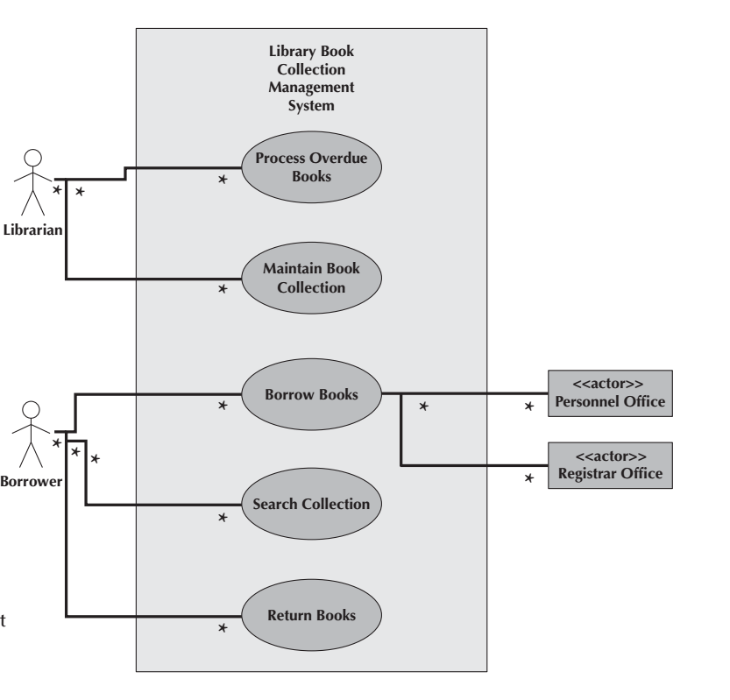
Second example

Slide 19
What should you do for your project?
Create use-case diagram, level 0.
We will work in the lab.

Slide 20
Reference
Dennis, Wixon, Tegarden, “System Analysis and Design, An Object Oriented Approach with UML”, 5th Edition, 2015.
Valacich, J. S., J. F. George, “Modern systems analysis and design”, 8th Edition, 2017.

